Slide 1
Employee Dataset
Data Cleaning, Analysis & Visualisation
Dataset: messy_dataset_Mukesh.csv • 10 raw records • 6 columns
Task 1: Load & Inspect
Task 2: Data Cleaning
Task 3: Statistics
Task 4: Outlier Detection
Task 5: Visualisation
Task 6: Correlation

Slide 2
What Was Wrong With the Raw Data?
Before we could analyse anything, the dataset had 7 different types of problems that needed fixing.
⚠
Duplicate Row
❓
Missing Values
Bob appeared twice — once missing Age, once missing Salary. Only one record should exist per person.
Eve had no ID, one row had no Name, Heidi had no Age or Salary, Grace had no Country, Charlie had no Join Date.
🔤
Text in Number Columns
📅
Invalid Date
Age said 'thirty-eight' and Salary said 'sixty five thousand' — computers can't do maths with words.
One date was '2019-13-01' — there is no 13th month. This was unreadable and treated as missing.
🌍
Inconsistent Country Codes
🔢
Wrong Data Types
The same country (Australia) was written as both 'AU' and 'AUS'. This splits the data into two separate groups unnecessarily.
All columns were read as plain text because of the mixed content above — Age and Salary could not be used in calculations.

Slide 3
How Each Problem Was Fixed
1
Words in number fields
Replaced "thirty-eight" → 38 and "sixty five thousand" → 65000, then converted to proper numbers.
2
Invalid & mixed date formats
Tried multiple date patterns (DD/MM/YYYY, YYYY-MM-DD, YYYY-DD-MM). Others filled by carry-forward.
3
Country code inconsistency
"AU" was renamed to "AUS" so Australia is treated as one unified group throughout the analysis.
4
Missing IDs and Names
Eve was assigned the next logical ID (6). The unnamed employee was labelled 'Unknown' to preserve the row.
5
Missing Age & Salary
Filled with the median value — the middle number — which is more reliable than the average when data is limited.
6
Missing Country & Date
Country filled with the most common value (NZ — mode). Join Date carried forward from the previous row.
7
Duplicate Bob rows
The two Bob entries were merged into one — keeping the first complete row and discarding the second.

Slide 4
The Cleaned Dataset
ID
Name
Age
Country
Salary
Join Date
What changed?
1
Alice
25
NZ
$55,000
15 Jan 2020
✅ Bob merged into a single row
2
Bob
29.5
NZ
$60,000
20 Feb 2020
✅ Eve assigned ID 6
4
Charlie
35
AUS
$72,000
20 Feb 2020
✅ Row 7 named 'Unknown'
✅ 'thirty-eight' → 38
5
David
38
NZ
$68,000
01 Nov 2019
✅ Salary text → numbers
6
Eve
29
AUS
$59,000
13 Jan 2019
✅ AU standardised to AUS
7
Unknown
40
NZ
$65,000
30 May 2018
✅ Missing Age → median
8
Grace
22
NZ
$64,000
25 Jul 2021
✅ Missing Salary → median
9
Heidi
29.5
AUS
$62,000
25 Jul 2021
✅ Missing Country → mode
✅ Invalid date → ffill
10
Ivan
27
NZ
$58,000
15 Mar 2019

Slide 5
Basic Statistical Summary
Age (years)
Team Breakdown
30.5
29.5
22
40
NZ
Average
Median
Youngest
Oldest
6 employees · 67% of team
Salary (NZD)
AUS
$62,556
$62,000
$55,000
$72,000
3 employees · 33% of team
Average
Median
Lowest
Highest
Salary range is narrow: only $17,000 separates the lowest and highest earners, suggesting a relatively flat pay structure within this team.

Slide 6
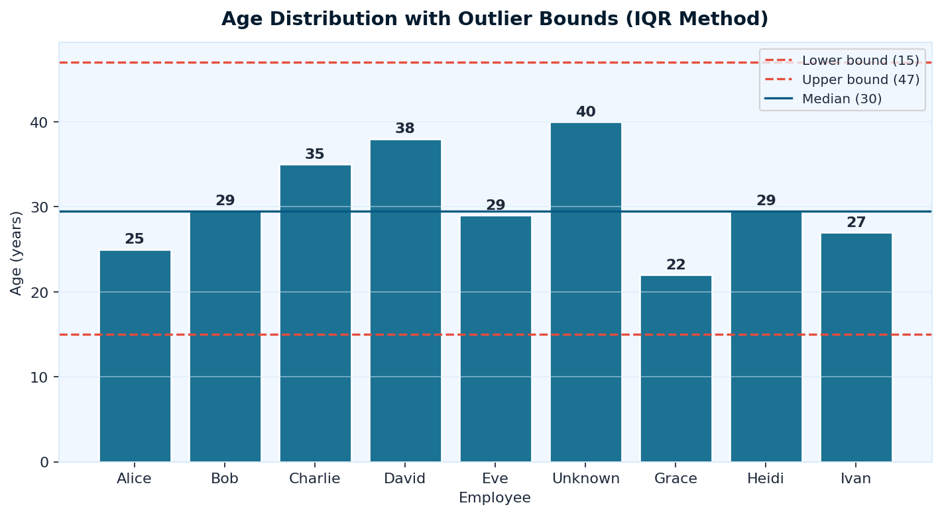
Outlier Detection — Age (IQR Method)
What is an Outlier?
An outlier is a value that is unusually far from the rest of the data — much higher or much lower than typical.
We used the IQR (Interquartile Range) method, which defines safe bounds as:
Lower = Q1 − 1.5 × IQR
Upper = Q3 + 1.5 × IQR
Age Result
✅ No outliers found
Bounds: 15 – 47 years
All employees fall comfortably within this range. The team is young (22) to mid-career (40) — a normal distribution for a working team.

Slide 7
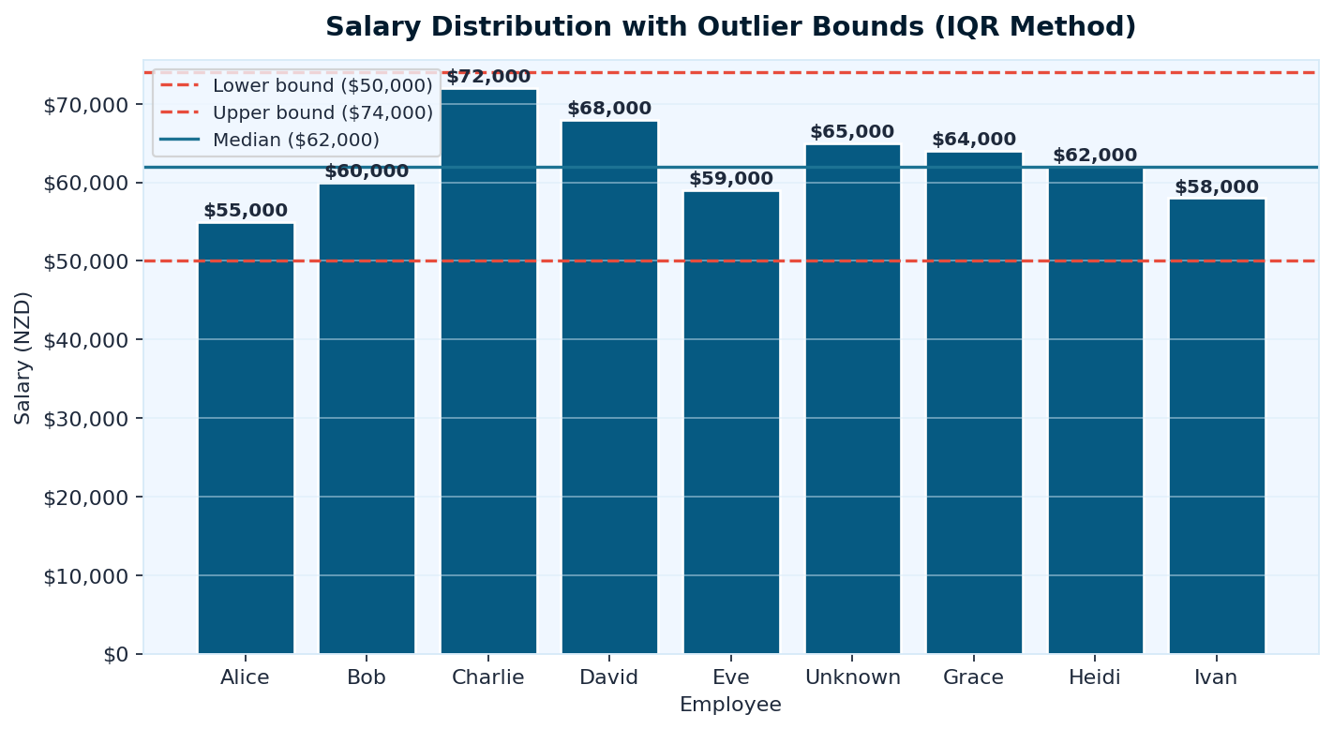
Outlier Detection — Salary (IQR Method)
Salary Result
✅ No outliers found
Bounds: $50,000 – $74,000
All 9 salaries fall within these limits. Charlie's $72,000 is the highest but still within the acceptable range.
What if there WERE outliers?
If someone earned $200,000 while everyone else earns ~$60,000, that one value would dramatically skew the average upward — making the data misleading.
Outliers can result from data entry errors, exceptional cases, or genuine anomalies worth investigating separately.

Slide 8
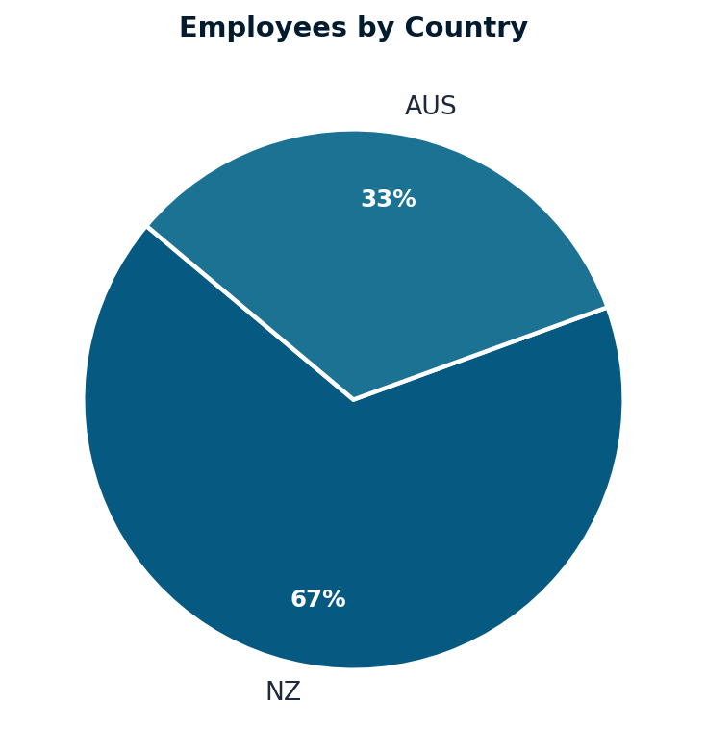
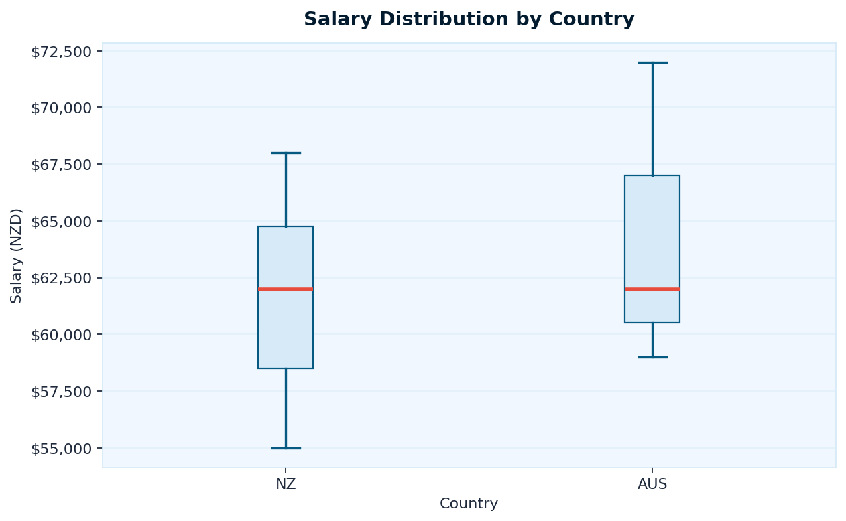
Team Composition & Salary by Country
Left chart: 67% of the team is based in New Zealand (6 people), 33% in Australia (3 people). Right chart: The boxplot shows how salaries are spread within each country. AUS employees appear to have a slightly higher median salary and wider range. The red line inside each box is the median salary.

Slide 9
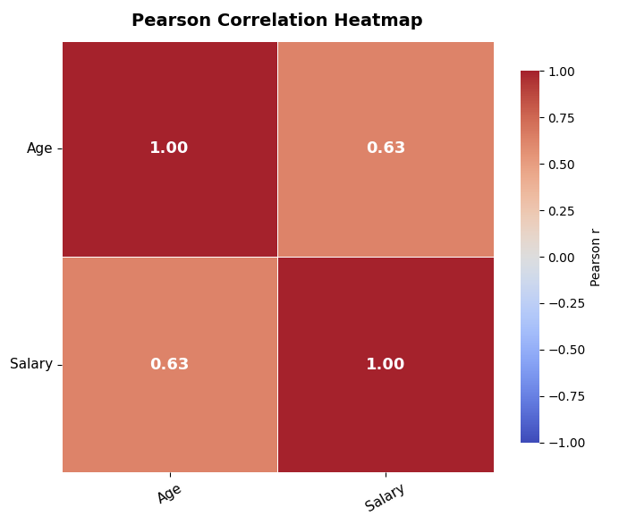
Pearson Correlation Heatmap
How to Read This Chart
Each number shows how strongly two columns move together, on a scale from −1 to +1.
+1 = move perfectly together | −1 = move perfectly opposite | 0 = no relationship
0.63
Age ↔ Salary
Moderate positive link. Older employees tend to earn more — likely reflecting experience and career progression.

Slide 10
Summary
Employee Dataset — Key Takeaways
Data Cleaned
No Outliers
1
Fixed 7 types of issues — text-as-numbers, duplicates, inconsistent codes, invalid dates, and 8 missing values across 6 columns.
2
Both Age (15–47 range) and Salary ($50K–$74K range) had zero outliers. All values are within expected real-world bounds.
Team is NZ-heavy
Age drives Salary
3
6 of 9 employees (67%) are based in NZ, 3 in AUS (33%). AUS employees have a slightly higher median salary.
4
The strongest correlation (r=0.63) is between Age and Salary. More experienced employees earn more — as expected.
Narrow Pay Band
5
Salaries range only $17,000 ($55K–$72K), suggesting consistent pay structure regardless of country or join year.

